Slide 1

Brainware University
Name: Akash Das
Student Code: BWU/BTA/21/002
Course Code: PEC-CSM701A
Course Name: Cloud Computing
Topic: Neural Networks: Architecture and Function

Slide 2
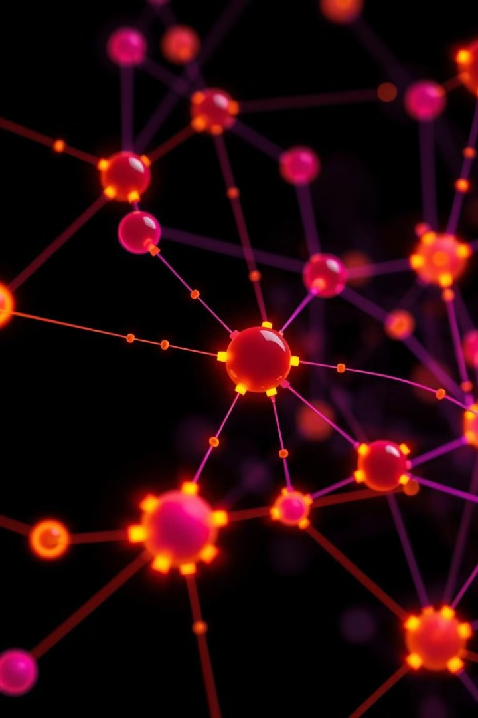

Neural Networks: Architecture and Function
Neural networks are a powerful machine learning technique inspired by the human brain. They excel at pattern recognition, decision-making, and solving complex problems.
by Akash Das

Slide 3
Biological Inspiration
Neurons
Neural networks are inspired by the structure and functioning of the human brain, particularly by how neurons (nerve cells) work together to process information, make decisions, and learn.

Slide 4

Artificial Neurons and Connections
1
Inputs
Artificial neurons receive input signals, similar to the dendrites of biological neurons.
2
Weights
Each input is assigned a weight, representing the strength of its connection.
3
Activation
The neuron's output is determined by an activation function applied to the weighted sum of inputs.

Slide 5

Feedforward Neural Networks
Input Layer
Hidden Layers
Output Layer
The input layer receives the initial data or features to be processed.
The hidden layers perform complex transformations and feature extraction on the input data.
The output layer produces the final predicted results or classifications.

Slide 6
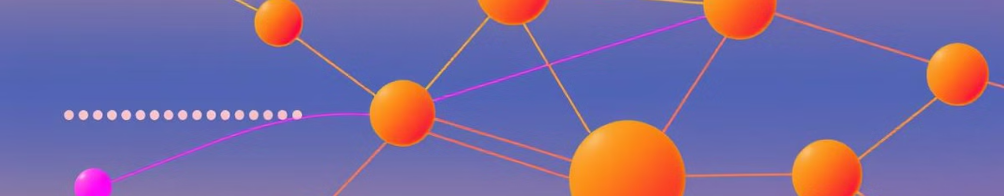



Backpropagation and Training
Forward Propagation
Error Calculation
Backpropagation
Data flows from the input layer through the hidden layers to the output layer.
The difference between the predicted output and the true output is calculated.
The error is propagated backwards through the network to update the weights.

Slide 7

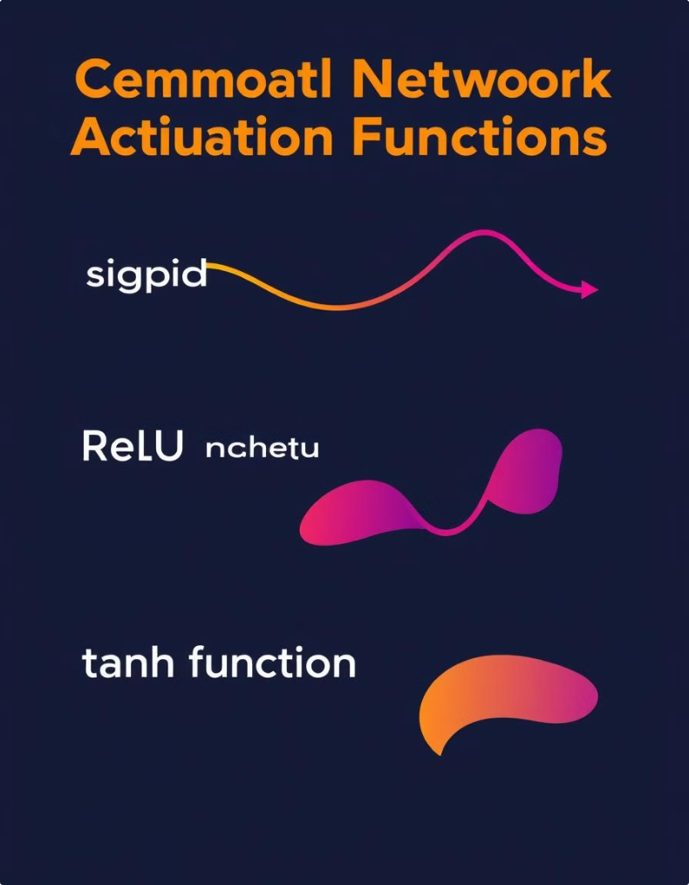



Activation Functions
Activation function is used to generate or define a particular output for a given node based on the input is getting provided.
Sigmoid
Squashes inputs between 0 and 1, useful for binary classification.
ReLU
Rectified Linear Unit, introduces non-linearity and speeds up training.
Tanh
Hyperbolic tangent, similar to sigmoid but outputs between -1 and 1.

Slide 8
Applications and Limitations
Applications
Limitations
Advancements
Neural networks excel in areas like computer vision, speech recognition, and predictive analytics.
They require large datasets for training, can be computationally intensive, and may struggle with interpretability.
Ongoing research aims to address limitations and expand the capabilities of neural networks.

Slide 9
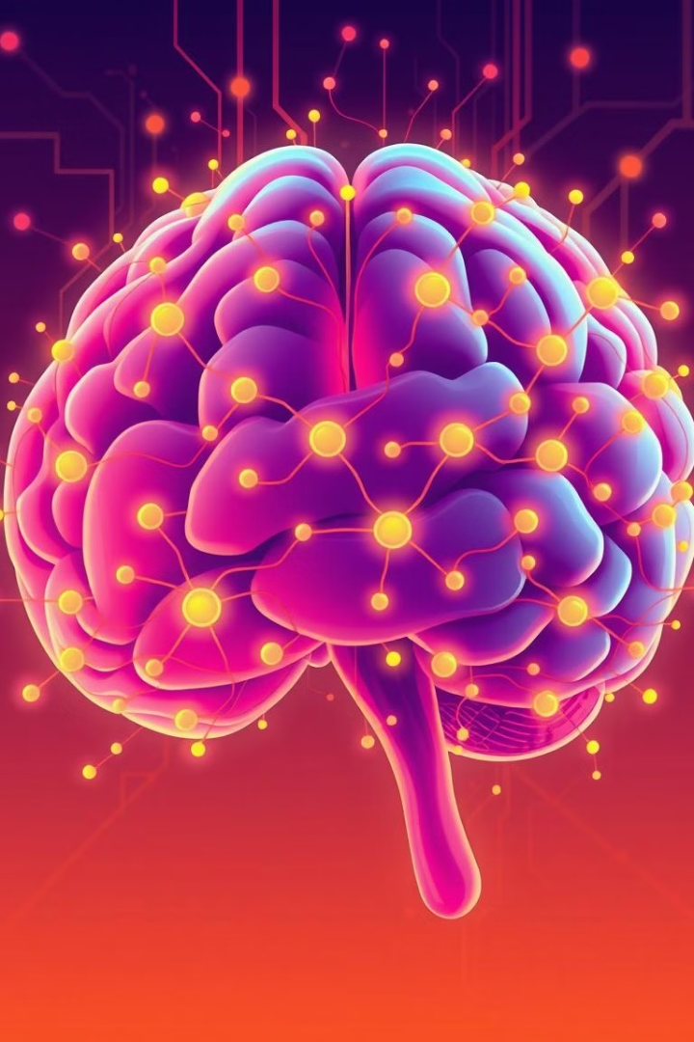
The Future of Neural Networks
1
Deep Learning
2
Neuromorphic Computing
Deeper neural network architectures are enabling more powerful and complex learning.
Hardware-based neural networks inspired by the brain's efficient energy use.
3
Explainable AI
Techniques to make neural networks more interpretable and transparent.

Slide 10
Thank You

